Slide 1
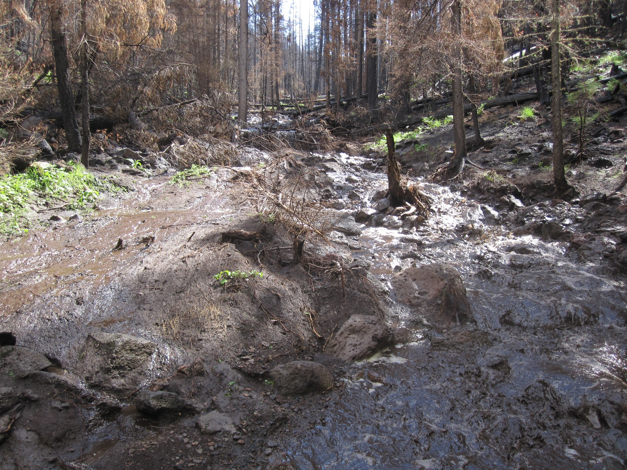



Forest Service FSWEPP Suite of Tools
Water Erosion Prediction Project
Pete Robichaud, Sarah Lewis, Scott Shepard (Bill Elliot)
Rocky Mountain Research Station
Mariana Dobre, Erin Brooks, Anurag Srivastava, Roger Lew
University of Idaho
Mary Ellen Miller Michigan Technological University

Slide 2
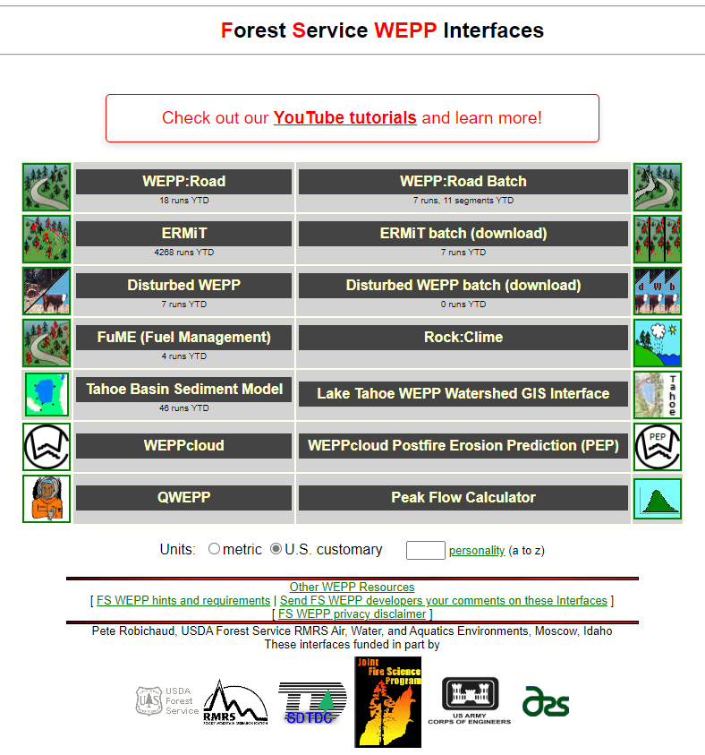
https://forest.moscowfsl.wsu.edu/fswepp/

Slide 3
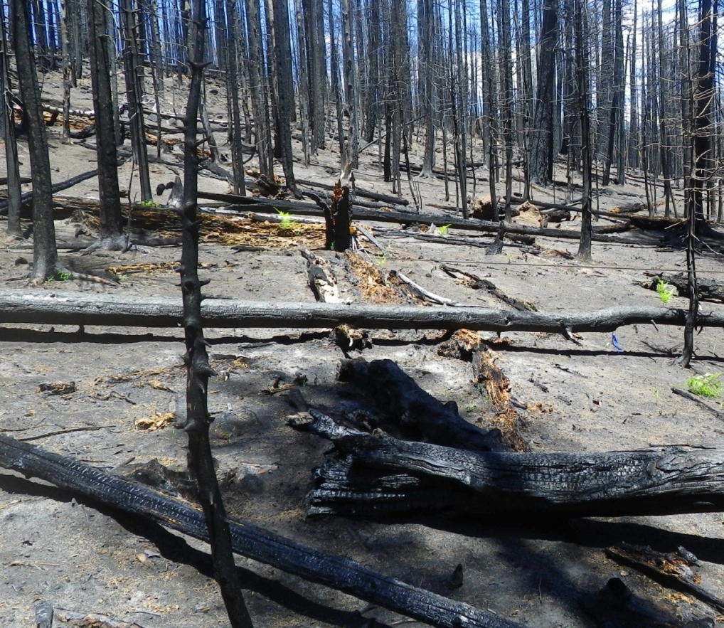
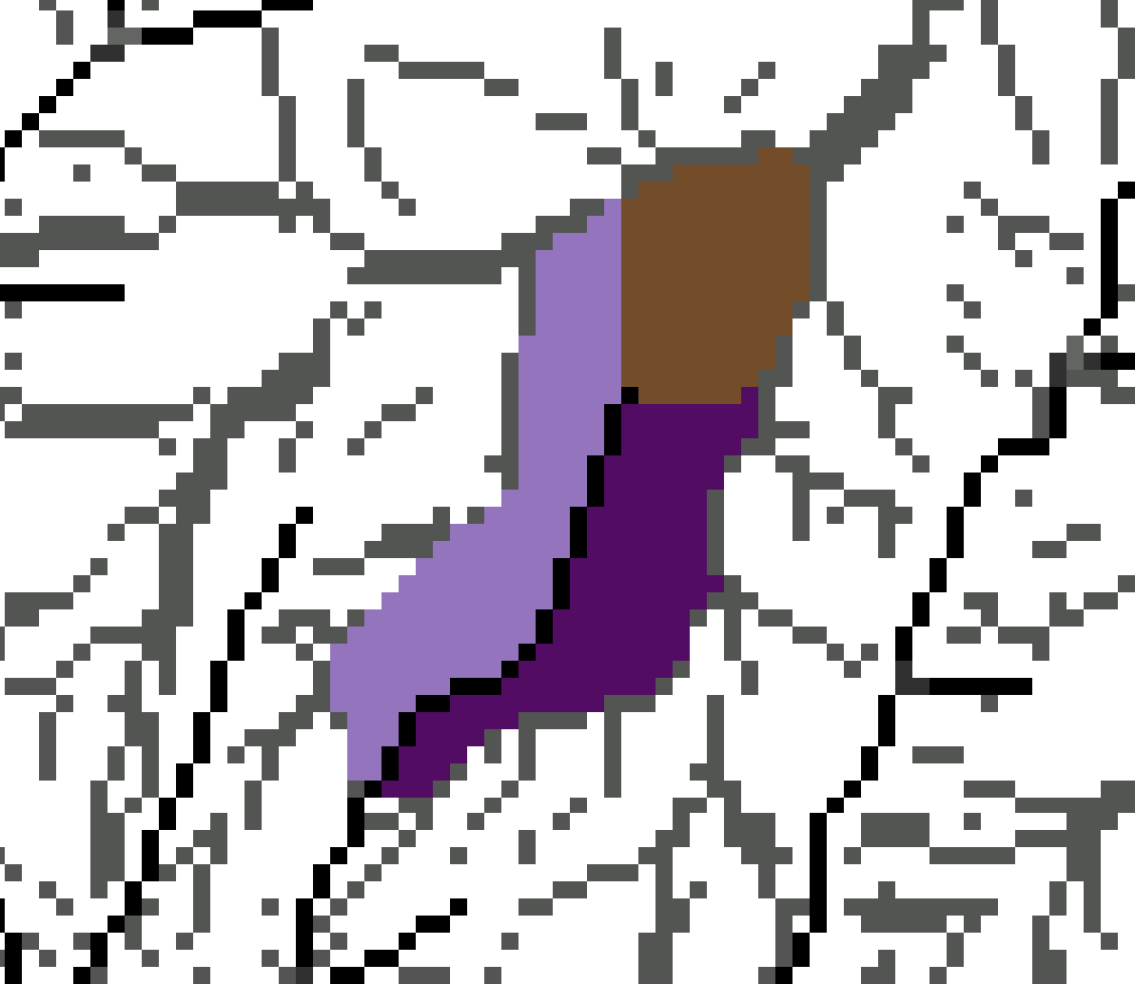
WEPP Models
Hillslope Modeling
Watershed Modeling
WEPPcloud
Disturbed WEPP
ERMiT
QWEPP
FuME
WEPPcloud-PEP
WEPP Road
More WEPPcloud Tools
Batch Processor

Slide 4
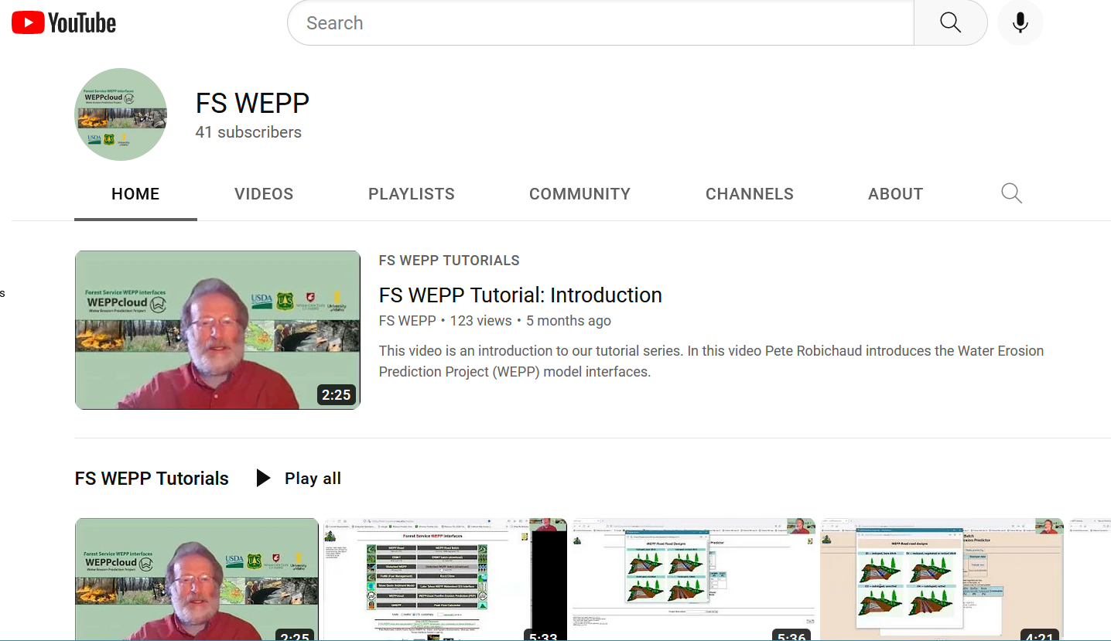
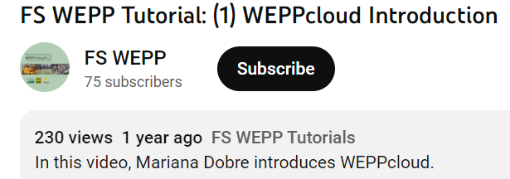
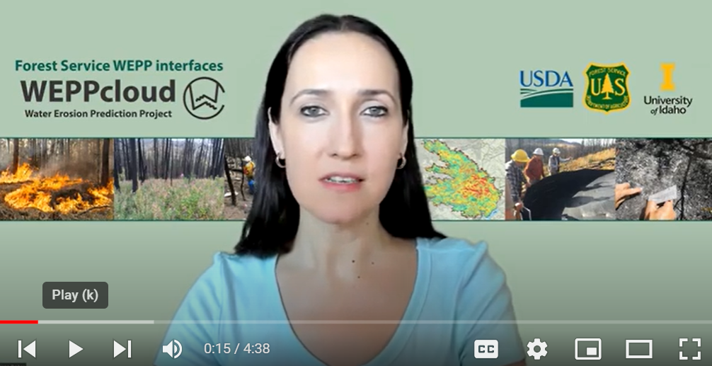
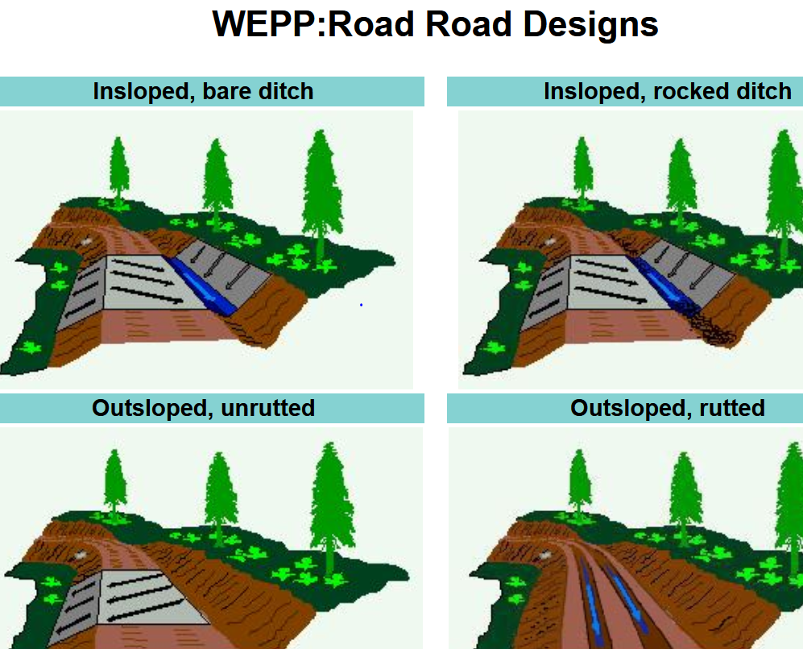
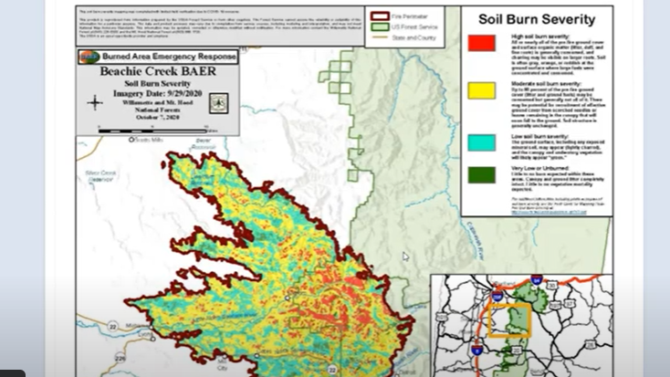
FS WEPP Channel
22 tutorials (3 to 14 min)
Follow along on your computer
Stop/start
Step by step

Slide 5
WEPPcloud Runs
Hillslope runs since January 1, 2021:
WEPPcloud: 11,189
WEPPcloud-PEP w/ WATAR: 28,910
WEPPcloud-EU: 2,730
WEPPcloud-AU: 9,313
WEPPcloud-RHEM: 8,702
WEPPcloud-(Un)Disturbed for United States: 8,016
Users
BAER Teams
Fed Agencies: FEMA,
FS, BLM, NPS, BOR, FWS, NRCS
State Agencies
County Managers
Consultants
Tribes
Water Utilities
Timber Industries
International Land Mgt Officials
“Over 1.6 million FSWEPP runs since 2010”

Slide 6
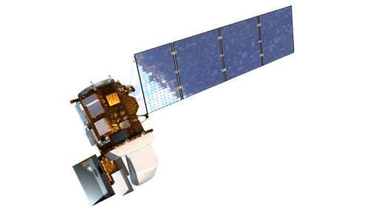
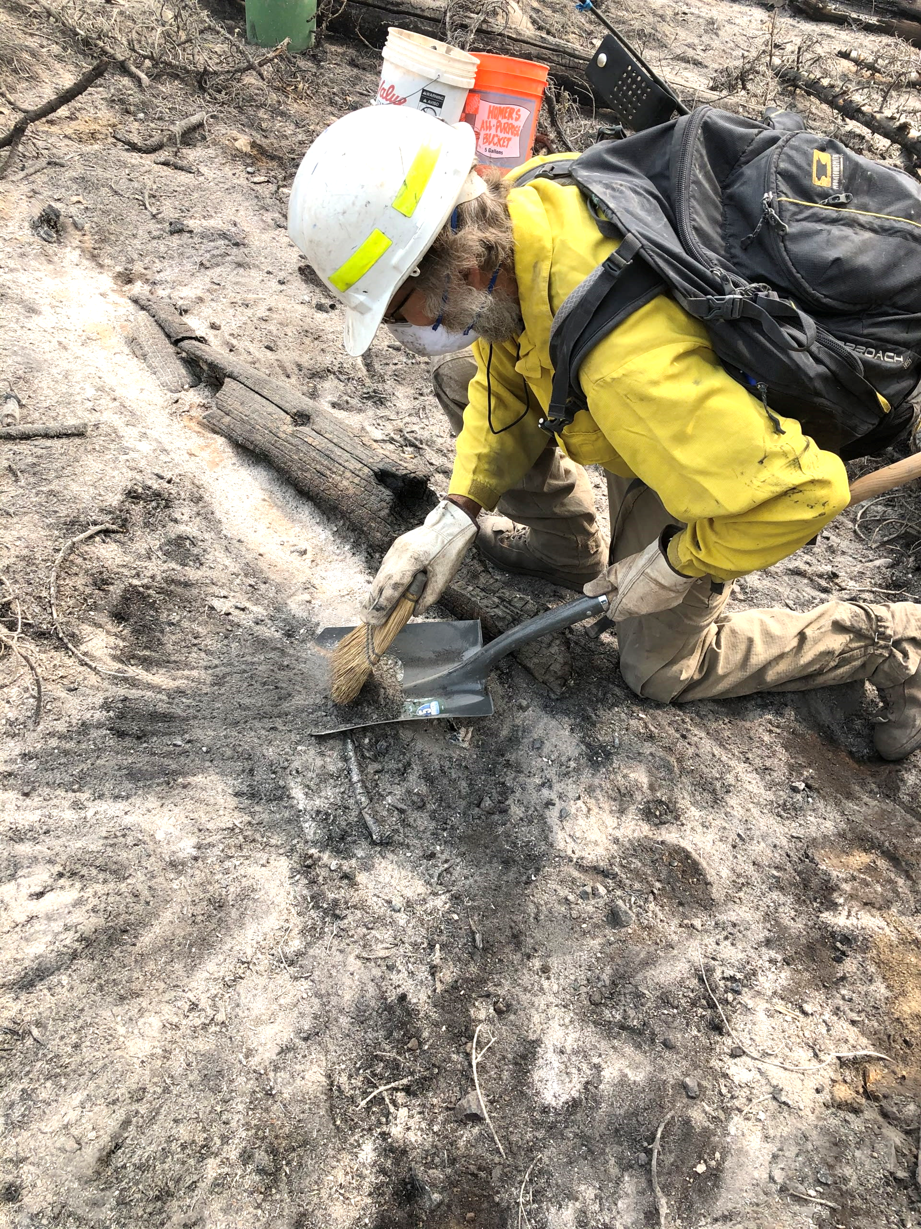
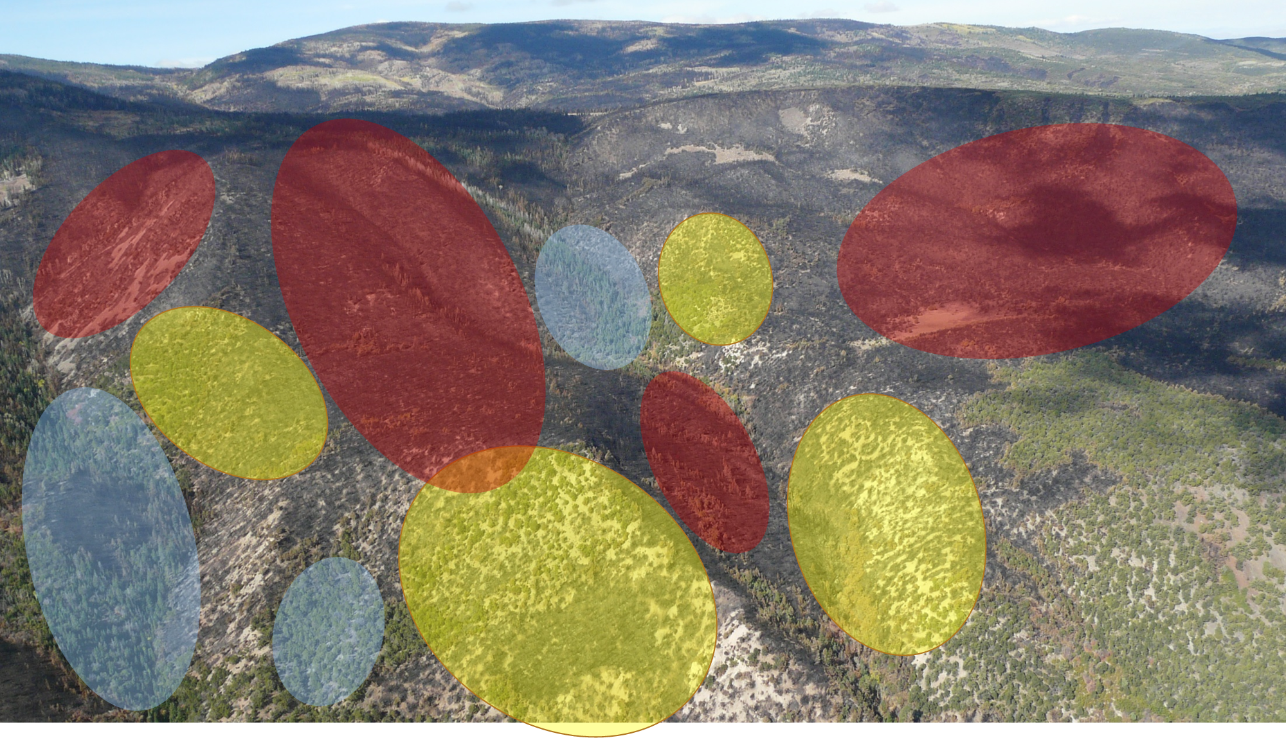

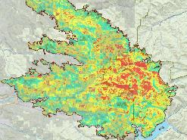
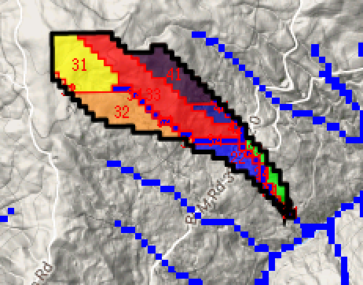
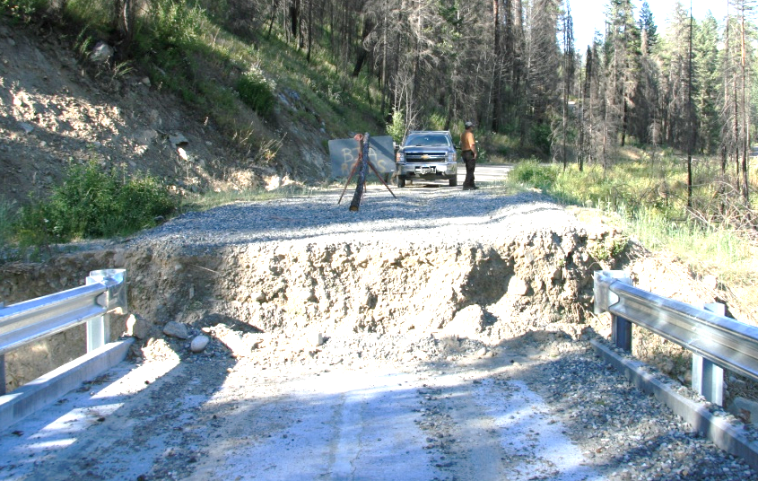
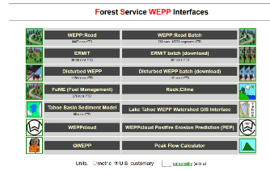
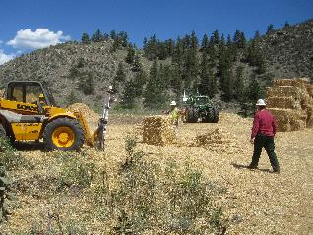
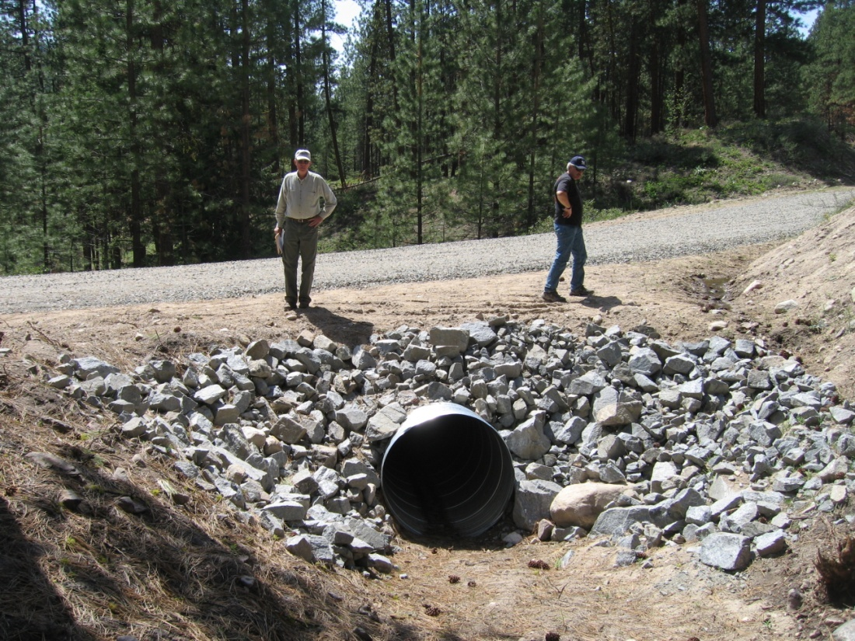
Burned Area Emergency Response (BAER) Process
These wildfires are everywhere these days. . .
Determine Spatial Burn Severity
Evaluate Values at Risk
Model Landscape
Creation of Soil Burn Severity Map
Field Verification
Implement Treatments and Monitor

Slide 7
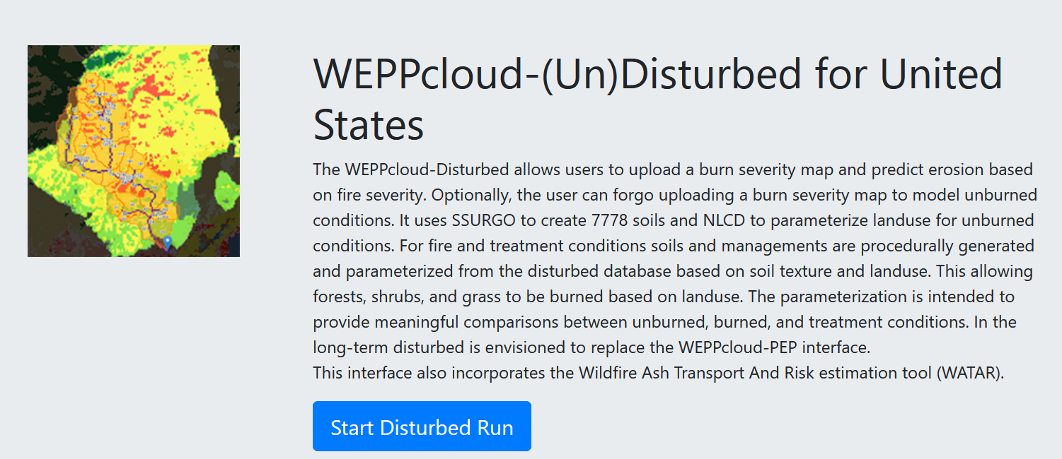
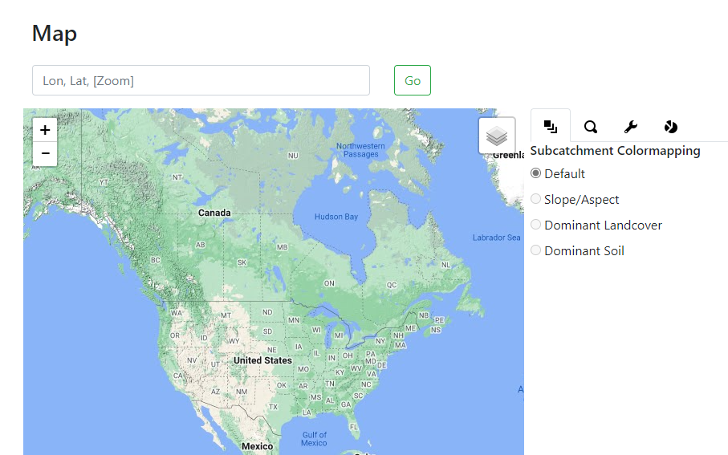
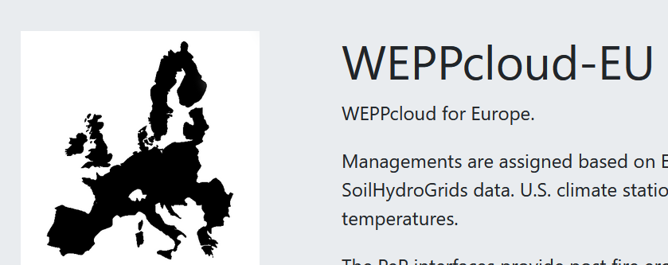
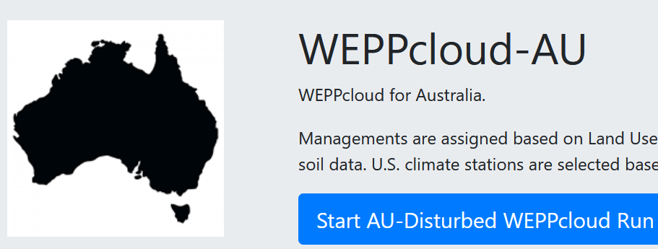
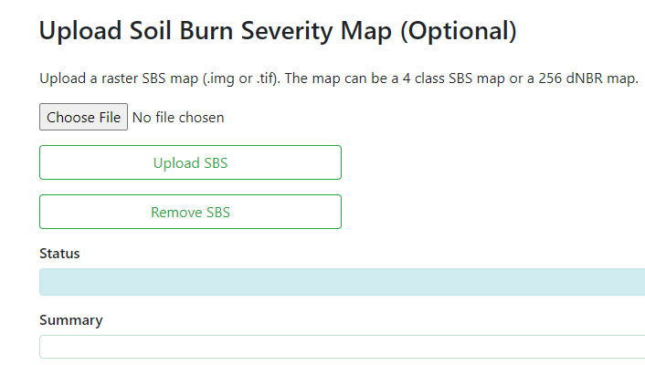

WEPPcloud
Welcome to

Slide 8
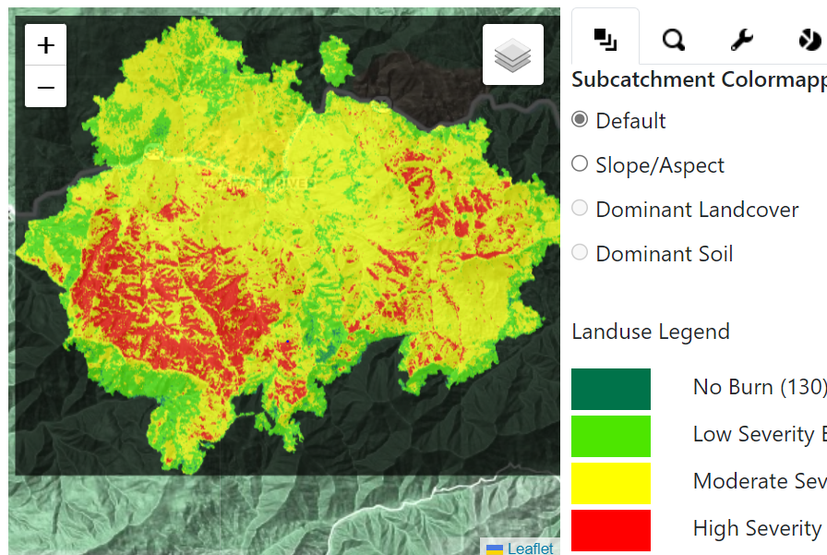
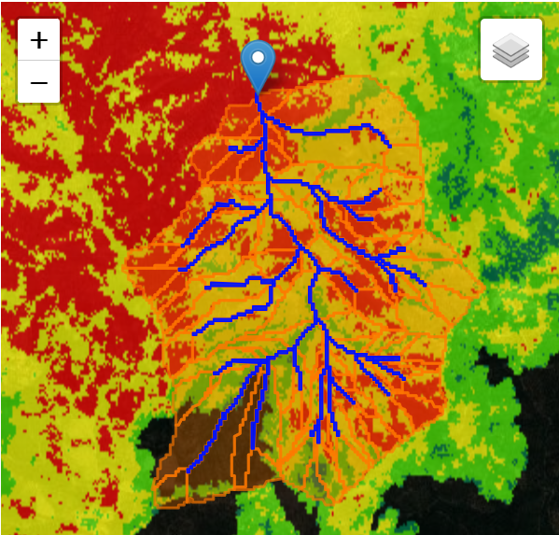
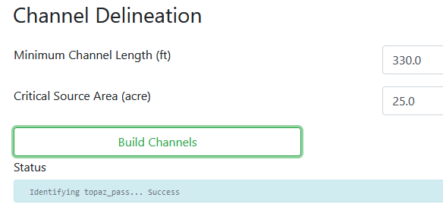
WEPPcloud: 2022 McKinney Fire, CA

Slide 9
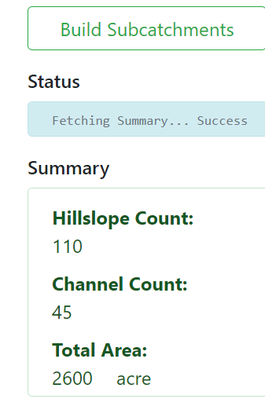
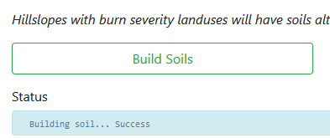
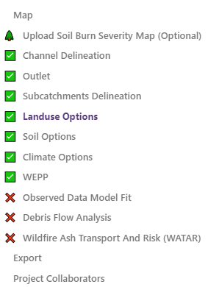
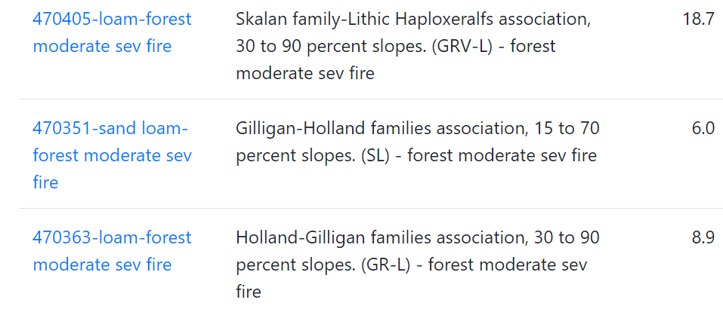
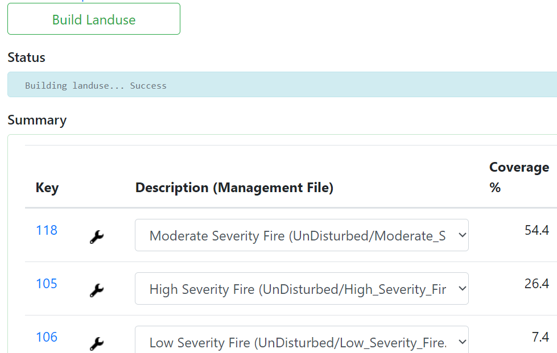
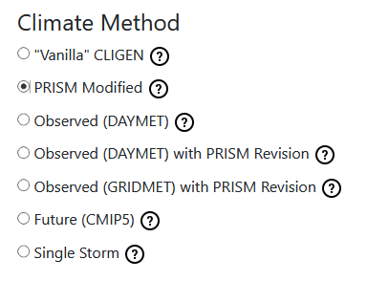
WEPPcloud: (Un)disturbed
CLIGEN historic observations
PRISM historic interpolated 4 km grid
DAYMET 1980-2019 1 km grid
GRIDMET 1980-yesterday 4 km grid
CMIP5 Future 2006-2099
Single storm or design storm

Slide 10
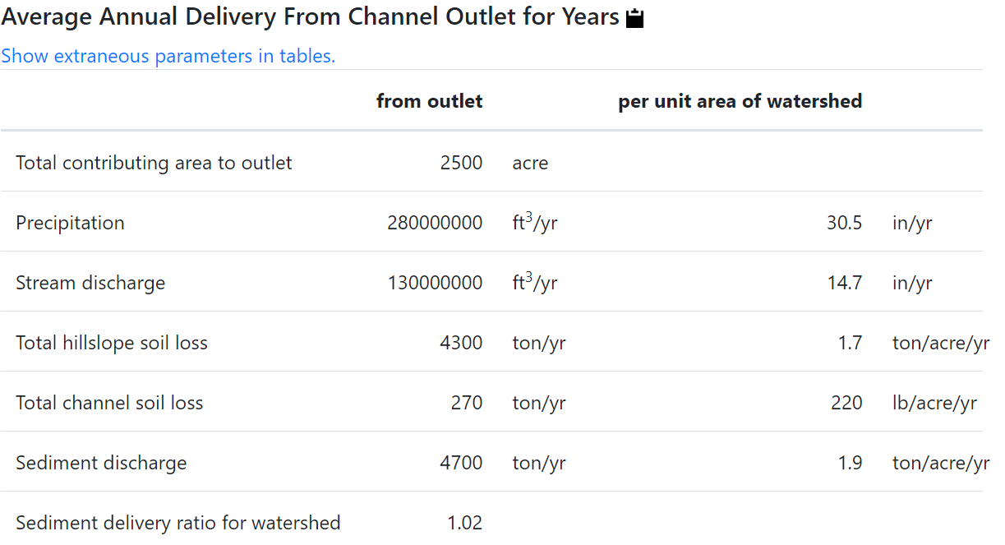
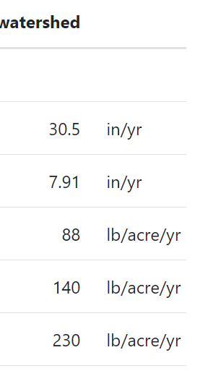
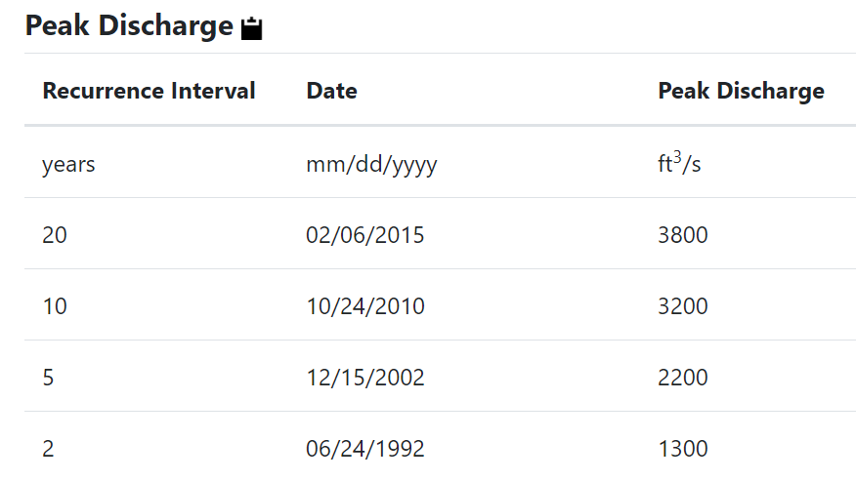
WEPPcloud
2022 McKinney Fire
Post-fire
Pre-fire

Slide 11
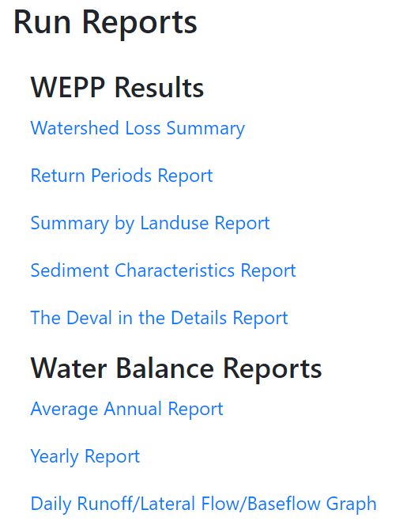
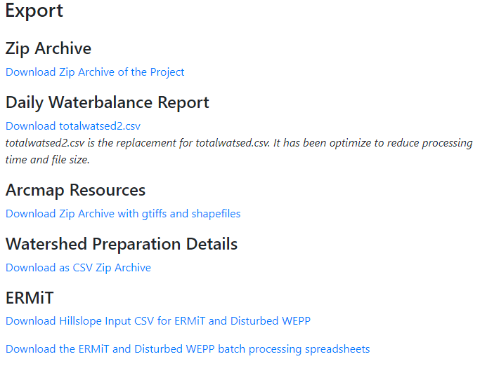
WEPPCloud: Output Options

Slide 12
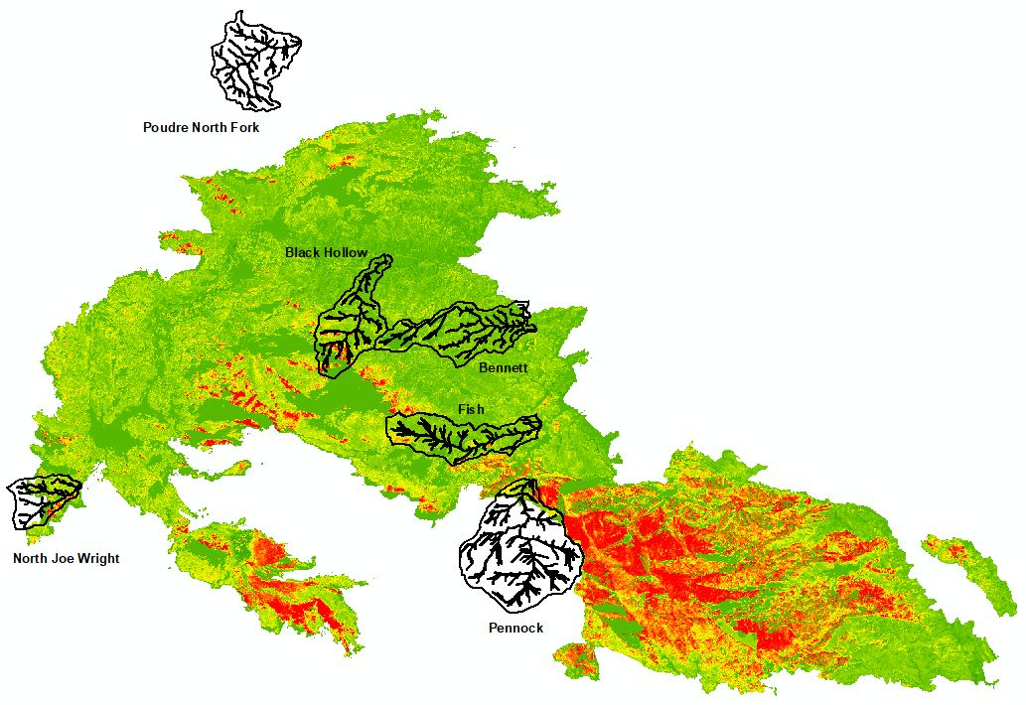
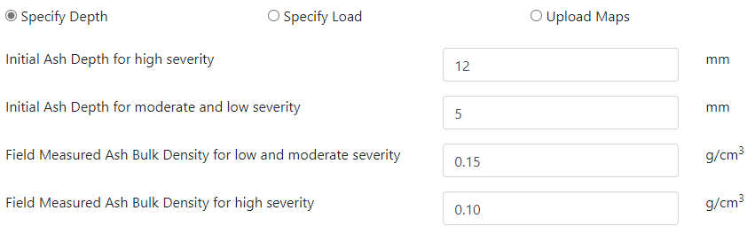
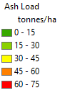

WEPPcloud-WATAR
Wildfire Ash Transport And Risk Tool
Or Upload Ash Load Map
2020 Cameron Peak Fire

Slide 13
  Simulated 2-yr Return Period Contaminants Delivery from Ash using Daymet Climate
Contaminants | Units | Black Hollow | Fish | Bennett | North Joe Wright
C | (mg/L) | 450 (-) | 340 (0.26) | 24 (2.53) | 1100 (0.39)
N | (mg/L) | 6.6 (0.22) | 2.0 (0.18) | 0.15 (0.19) | 6.6 (0.02)
K | (mg/L) | 2.1 (0.62) | 2.0 (0.55) | 0.15 (0.61) | 6.6 (0.02)
P | (mg/L) | 5.6 | 5.2 | 0.37 | 17
Ca | (mg/L) | 21 (2.73) | 28 (4.50) | 2.0 (8.76) | 89 (3.67)
Mg | (mg/L) | 6.2 (0.73) | 3.9 (0.87) | 0.28 (2.26) | 13 (0.42)
Na | (mg/L) | 1.7 (0.46) | 0.95 (1.14) | 0.069 (2.65) | 3.1 (-)
PO₄ | (mg/L) | 12 (0.08) | 2.0 (0.10) | 0.15 (0.07) | 6.6 (0.06)
Values in parenthesis are observed average over 2021 and 2022 after subtracting background measured for undisturbed conditions.
Results demonstrate reasonable predictions with observations. 60% of the contaminant concentration were similar across the various watersheds

Slide 14
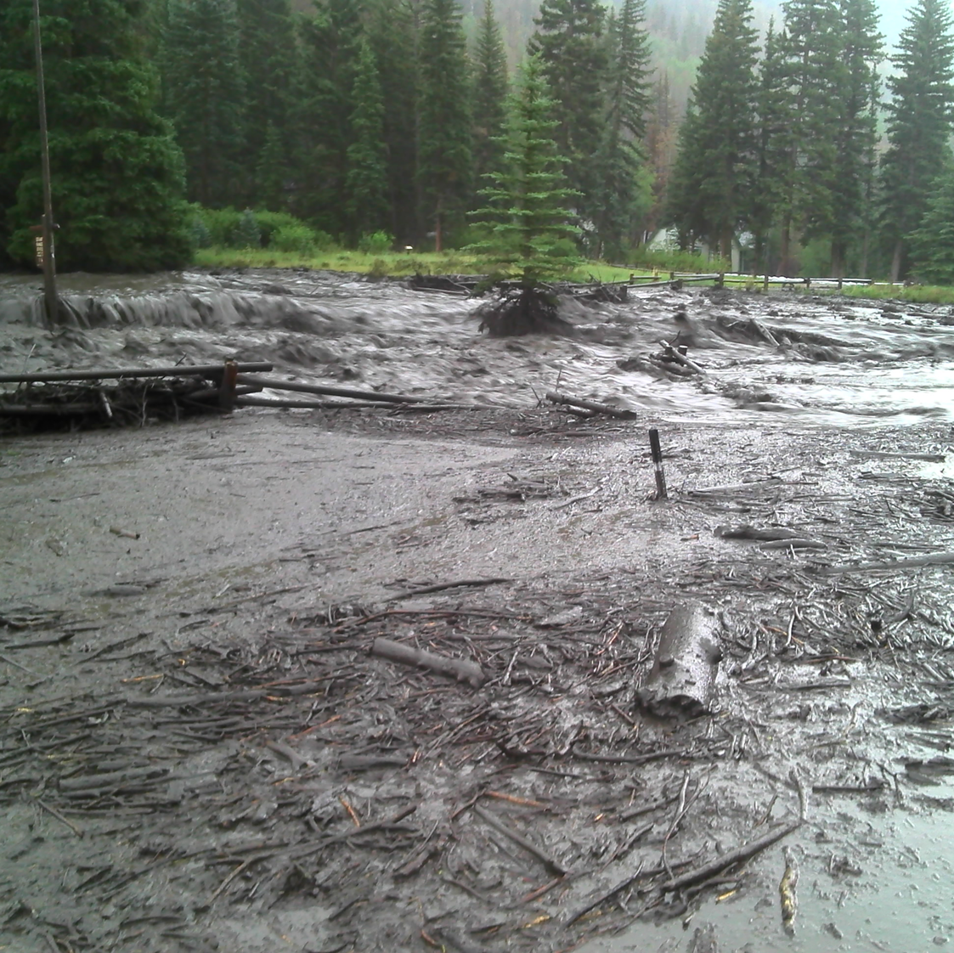
WEPP Knows Where Water Flows
Forest Service FSWEPP Suite of Tools
Hillslope and Watershed Modeling for Forest Conditions
1. Lew R, Dobre M, Srivastava A, et al. 2022. WEPPcloud: An online watershed-scale hydrologic modeling tool. Part I. Model description. Journal of Hydrology 608 127603
2. Deval C, Brooks ES, Dobre M, Lew R, et al. 2022. Pi-VAT: A web-based visualization tool for decision support using spatially complex water quality model outputs. Journal of Hydrology 607 127529
3. Dobre M, Srivastava A, Lew R, et al. 2022. WEPPcloud hydrologic and erosion simulation datasets from 28 watersheds in US Pacific Northwest and calibrating model parameters for undisturbed and disturbed forest management conditions. Data in Brief 108251
4. Dobre M, Srivastava A, Lew R, et al. 2022. WEPPcloud: An online watershed-scale hydrologic modeling tool. Part II. Model performance assessment and applications to forest management and wildfires. Journal of Hydrology 610 127776
“Over 1.6 million FSWEPP runs since 2010”
https://forest.moscowfsl.wsu.edu/fswepp/

